Slide 1
National Acute Hospital Review Emergency Department
January 2023

Slide 2
Table of Contents
Topic | Slide No.
Executive Summary | 3
Emergency Department
Attendances | 4
Quadrant | 27
PET | 31
Trolleys | 41
2

Slide 3
Executive Summary
KPI | Values | Comments
Monthly Attends | 111,226 | + 0.4 % compared to January 2022
 |  | + 0.4 % YTD
6 Hour PET | 56.8 % | Prior Month: 51.1 %
9 Hour PET | 72.9 % | Prior Month: 68.4 %
PET >= 24 hours | 5,932 | 94.7 % of all ED departures < 24 hours from registration.
8 AM Trolleys (YTD) | 10,451 | + 27.5 % compared to January 2022
 | 10,451 (YTD) | + 27.5 % compared to YTD 2022
3

Slide 4
Emergency Department Attendances
4

Slide 5
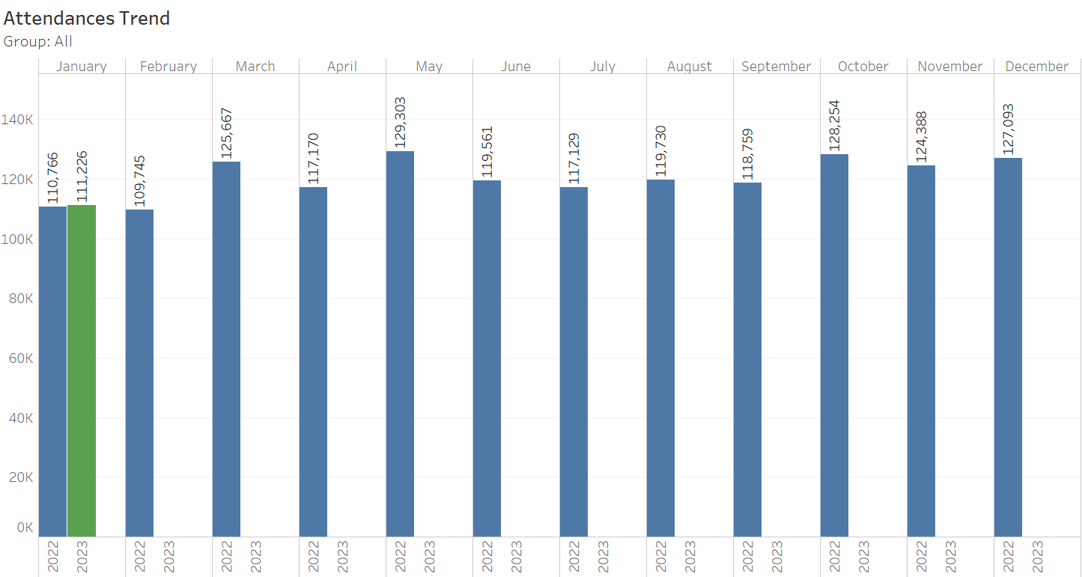
ED Attendances Trend 2023 v 2022
5
Notes:
5

Slide 6
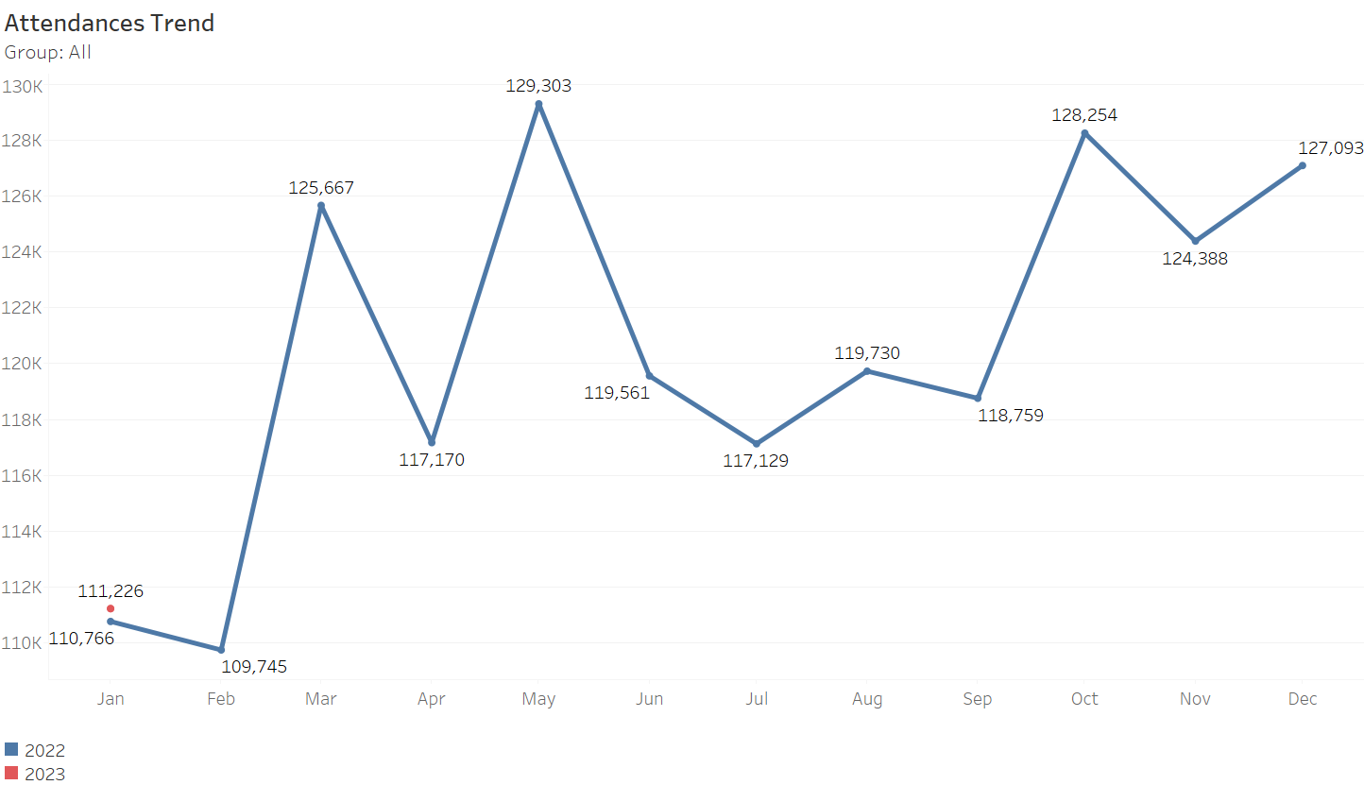
ED Attendances Trend 2023 v 2022
6
Notes:
6

Slide 7
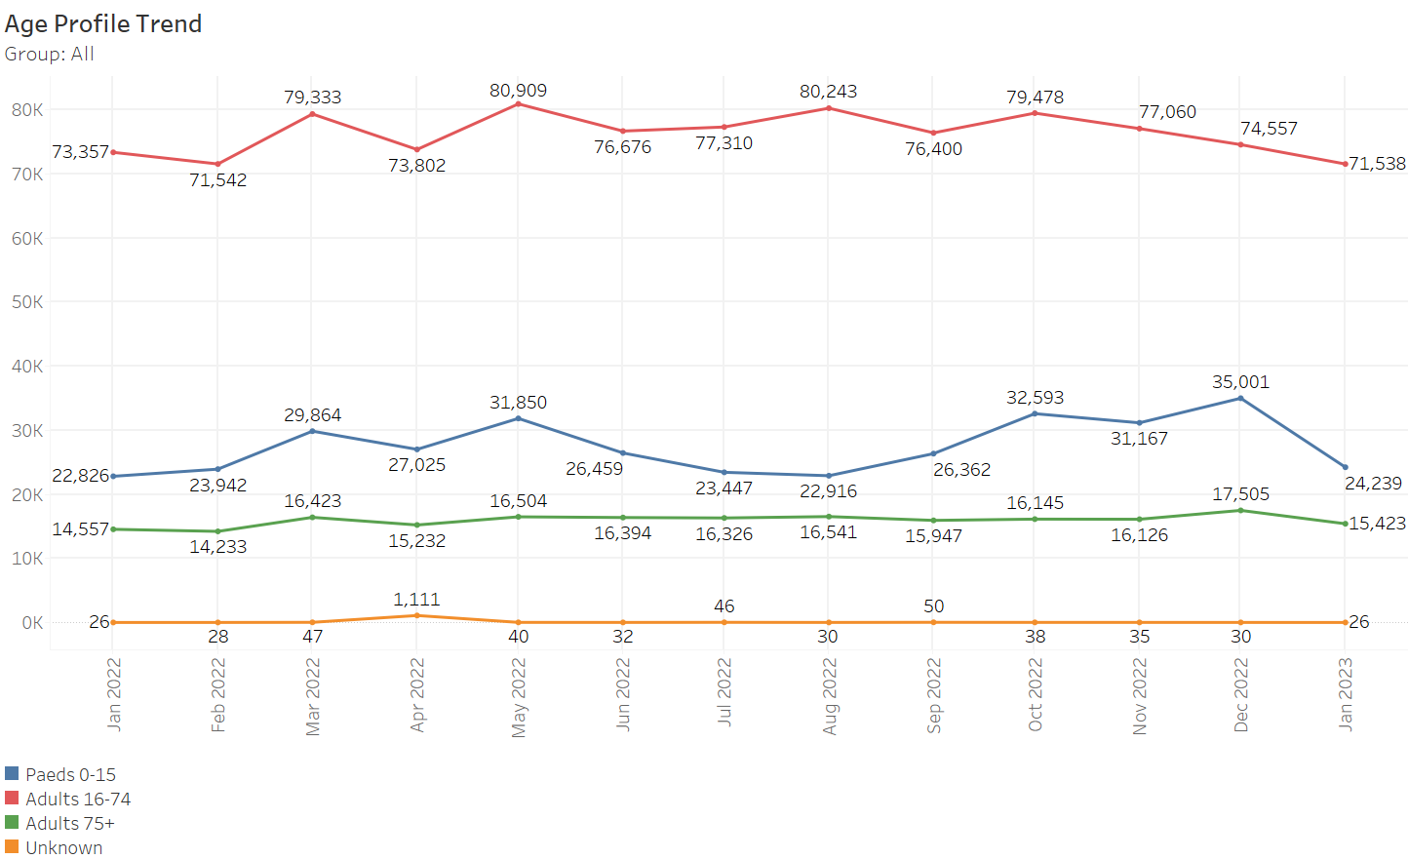
ED Attendances by Age Profile
7

Slide 8
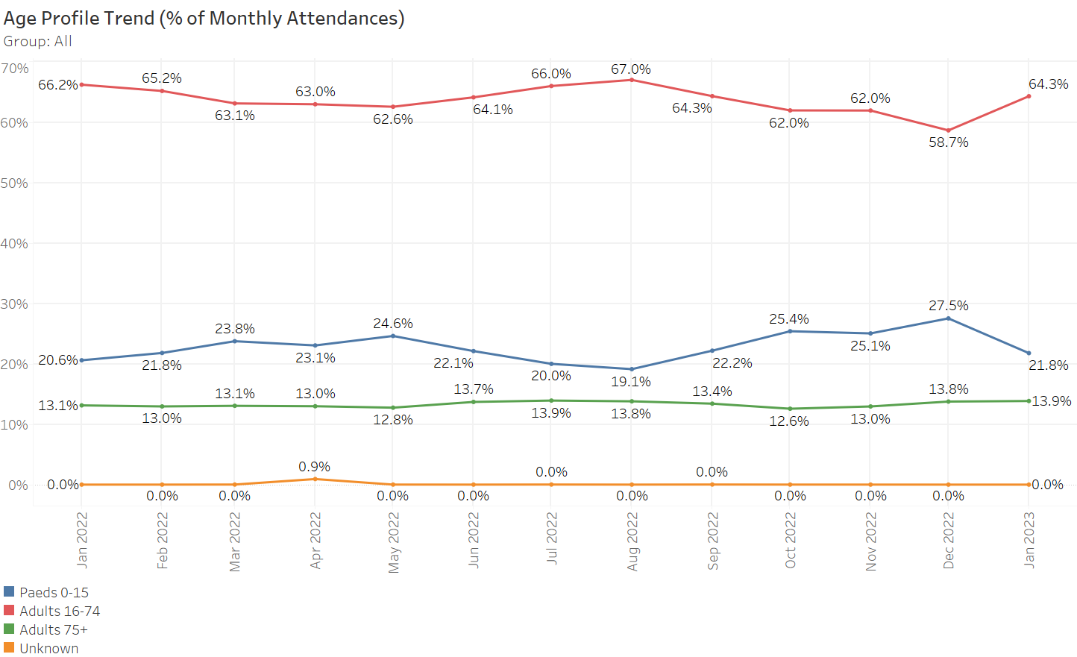
ED Attendances by Age Profile (% of Total)
8

Slide 9
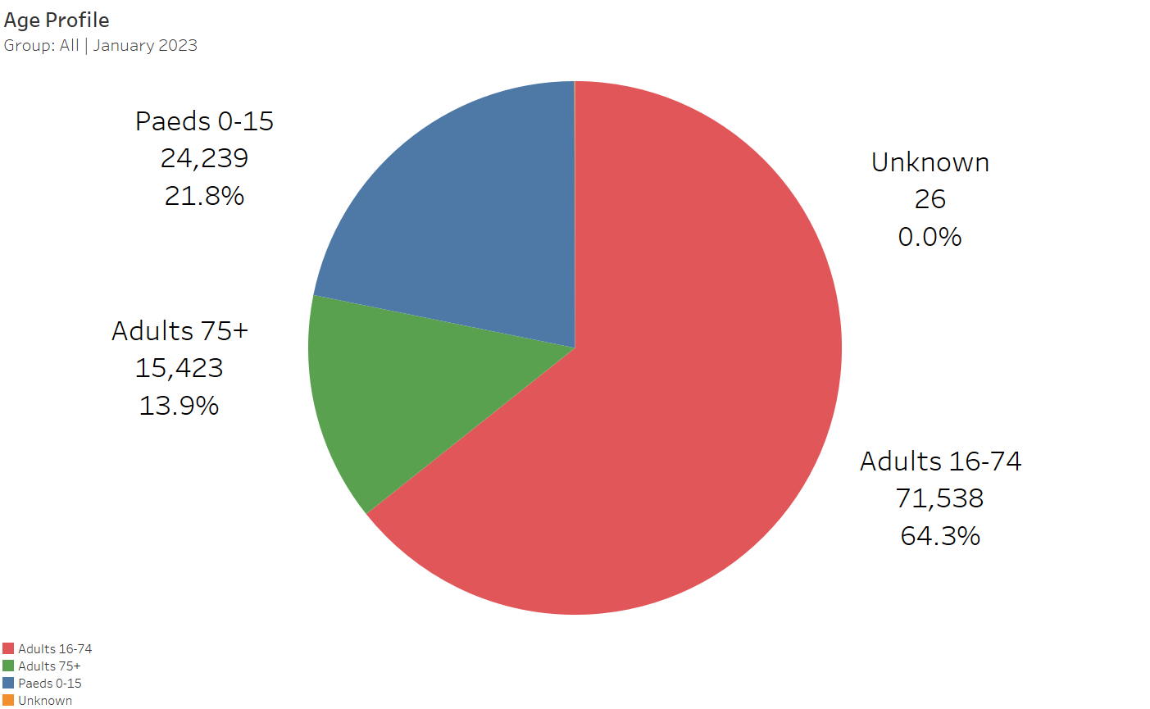
ED Attendances by Age Profile (Pie Chart)
9

Slide 10
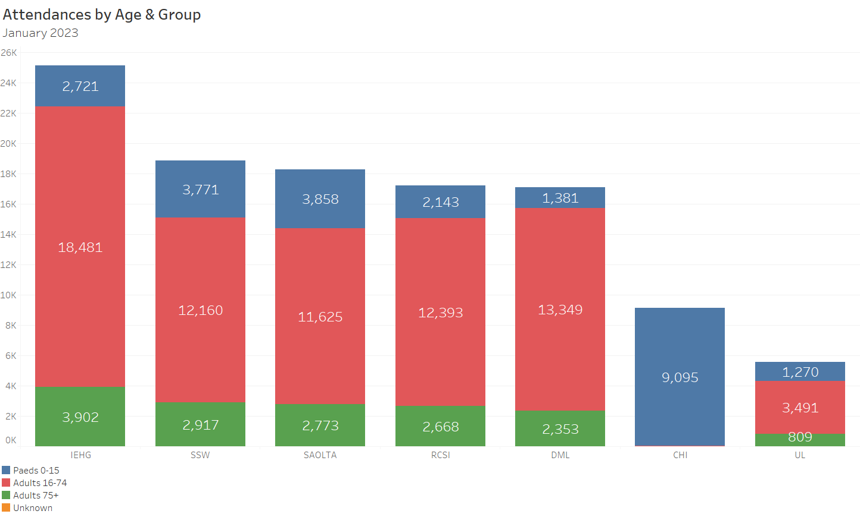
ED Attendances by Age – Group Detail
10

Slide 11
ED Attendances Month & YTD (Ages: All)
ED Attendances
 |  | 2023 |  |  | 2022 |  |  | Difference
Hospital Group | Hospital | January | YTD |  | January | YTD |  | January | YTD
Children's Health Ireland | Crumlin | 3,135 | 3,135 |  | 3,010 | 3,010 |  | +4.2% | +4.2%
 | Tallaght Paed | 2,563 | 2,563 |  | 2,403 | 2,403 |  | +6.7% | +6.7%
 | Temple Street | 3,438 | 3,438 |  | 3,691 | 3,691 |  | -6.9% | -6.9%
Dublin Midlands Hospitals Group | Naas | 2,409 | 2,409 |  | 2,267 | 2,267 |  | +6.3% | +6.3%
 | Portlaoise | 3,330 | 3,330 |  | 3,072 | 3,072 |  | +8.4% | +8.4%
 | St James's | 4,259 | 4,259 |  | 4,135 | 4,135 |  | +3% | +3%
 | Tallaght Adult | 4,102 | 4,102 |  | 4,177 | 4,177 |  | -1.8% | -1.8%
 | Tullamore | 2,985 | 2,985 |  | 3,002 | 3,002 |  | -0.6% | -0.6%
Ireland East Hospital Group | Mater | 7,692 | 7,692 |  | 7,321 | 7,321 |  | +5.1% | +5.1%
 | Mullingar | 3,554 | 3,554 |  | 3,182 | 3,182 |  | +11.7% | +11.7%
 | Navan | 1,837 | 1,837 |  | 2,008 | 2,008 |  | -8.5% | -8.5%
 | St Luke's Kilkenny | 3,567 | 3,567 |  | 3,385 | 3,385 |  | +5.4% | +5.4%
 | St Vincent's | 4,661 | 4,661 |  | 5,234 | 5,234 |  | -10.9% | -10.9%
 | Wexford | 3,811 | 3,811 |  | 3,555 | 3,555 |  | +7.2% | +7.2%
RCSI Hospitals Group | Beaumont | 4,933 | 4,933 |  | 5,180 | 5,180 |  | -4.8% | -4.8%
 | Cavan | 2,819 | 2,819 |  | 2,889 | 2,889 |  | -2.4% | -2.4%
 | Connolly | 4,062 | 4,062 |  | 4,025 | 4,025 |  | +0.9% | +0.9%
 | OLOL | 5,391 | 5,391 |  | 5,454 | 5,454 |  | -1.2% | -1.2%
Saolta Healthcare University Hospital Group | Galway | 5,729 | 5,729 |  | 5,574 | 5,574 |  | +2.8% | +2.8%
 | Letterkenny | 3,897 | 3,897 |  | 3,506 | 3,506 |  | +11.2% | +11.2%
 | Mayo | 2,929 | 2,929 |  | 2,862 | 2,862 |  | +2.3% | +2.3%
 | Portiuncula | 2,333 | 2,333 |  | 2,121 | 2,121 |  | +10% | +10%
 | Sligo | 3,369 | 3,369 |  | 3,359 | 3,359 |  | +0.3% | +0.3%
South/South West Hospital Group | CUH | 5,526 | 5,526 |  | 5,762 | 5,762 |  | -4.1% | -4.1%
 | Kerry | 3,099 | 3,099 |  | 2,728 | 2,728 |  | +13.6% | +13.6%
 | Mercy | 2,531 | 2,531 |  | 3,135 | 3,135 |  | -19.3% | -19.3%
 | South Tipp | 2,573 | 2,573 |  | 2,484 | 2,484 |  | +3.6% | +3.6%
 | Waterford | 5,120 | 5,120 |  | 4,633 | 4,633 |  | +10.5% | +10.5%
University of Limerick Hospital Group | Limerick | 5,572 | 5,572 |  | 6,612 | 6,612 |  | -15.7% | -15.7%
National |  | 111,226 | 111,226 |  | 110,766 | 110,766 |  | +0.4% | +0.4%
11

Slide 12
ED Attendances Month & YTD (Ages: 0-15)
ED Attendances (Ages:0-15)
 |  | 2023 |  |  | 2022 |  |  | Difference
Hospital Group | Hospital | January | YTD |  | January | YTD |  | January | YTD
Children's Health Ireland | Crumlin | 3,117 | 3,117 |  | 3,008 | 3,008 |  | +3.6% | +3.6%
 | Tallaght Paed | 2,559 | 2,559 |  | 2,403 | 2,403 |  | +6.5% | +6.5%
 | Temple Street | 3,419 | 3,419 |  | 3,690 | 3,690 |  | -7.3% | -7.3%
Dublin Midlands Hospitals Group | Naas | 15 | 15 |  | 19 | 19 |  | -21.1% | -21.1%
 | Portlaoise | 1,069 | 1,069 |  | 923 | 923 |  | +15.8% | +15.8%
 | St James's | 1 | 1 |  | 0 | 0
 | Tullamore | 296 | 296 |  | 329 | 329 |  | -10% | -10%
Ireland East Hospital Group | Mater | 4 | 4 |  | 1 | 1 |  | +300% | +300%
 | Mullingar | 903 | 903 |  | 831 | 831 |  | +8.7% | +8.7%
 | Navan | 11 | 11 |  | 8 | 8 |  | +37.5% | +37.5%
 | St Luke's Kilkenny | 877 | 877 |  | 740 | 740 |  | +18.5% | +18.5%
 | St Vincent's | 28 | 28 |  | 19 | 19 |  | +47.4% | +47.4%
 | Wexford | 898 | 898 |  | 782 | 782 |  | +14.8% | +14.8%
RCSI Hospitals Group | Beaumont | 3 | 3 |  | 2 | 2 |  | +50% | +50%
 | Cavan | 700 | 700 |  | 610 | 610 |  | +14.8% | +14.8%
 | Connolly | 4 | 4 |  | 2 | 2 |  | +100% | +100%
 | OLOL | 1,436 | 1,436 |  | 1,357 | 1,357 |  | +5.8% | +5.8%
Saolta Healthcare University Hospital Group | Galway | 1,302 | 1,302 |  | 1,118 | 1,118 |  | +16.5% | +16.5%
 | Letterkenny | 662 | 662 |  | 585 | 585 |  | +13.2% | +13.2%
 | Mayo | 639 | 639 |  | 560 | 560 |  | +14.1% | +14.1%
 | Portiuncula | 652 | 652 |  | 523 | 523 |  | +24.7% | +24.7%
 | Sligo | 603 | 603 |  | 580 | 580 |  | +4% | +4%
South/South West Hospital Group | CUH | 1,230 | 1,230 |  | 1,144 | 1,144 |  | +7.5% | +7.5%
 | Kerry | 579 | 579 |  | 510 | 510 |  | +13.5% | +13.5%
 | Mercy | 404 | 404 |  | 501 | 501 |  | -19.4% | -19.4%
 | South Tipp | 587 | 587 |  | 472 | 472 |  | +24.4% | +24.4%
 | Waterford | 971 | 971 |  | 728 | 728 |  | +33.4% | +33.4%
University of Limerick Hospital Group | Limerick | 1,270 | 1,270 |  | 1,381 | 1,381 |  | -8% | -8%
National |  | 24,239 | 24,239 |  | 22,826 | 22,826 |  | +6.2% | +6.2%
12

Slide 13
ED Attendances Month & YTD (Ages: 75+)
ED Attendances (Ages:75+)
 |  | 2023 |  |  | 2022 |  |  | Difference
Hospital Group | Hospital | January | YTD |  | January | YTD |  | January | YTD
Children's Health Ireland | Temple Street | 1 | 1 |  | 0 | 0
Dublin Midlands Hospitals Group | Naas | 422 | 422 |  | 349 | 349 |  | +20.9% | +20.9%
 | Portlaoise | 313 | 313 |  | 276 | 276 |  | +13.4% | +13.4%
 | St James's | 584 | 584 |  | 560 | 560 |  | +4.3% | +4.3%
 | Tallaght Adult | 481 | 481 |  | 454 | 454 |  | +5.9% | +5.9%
 | Tullamore | 553 | 553 |  | 497 | 497 |  | +11.3% | +11.3%
Ireland East Hospital Group | Mater | 864 | 864 |  | 932 | 932 |  | -7.3% | -7.3%
 | Mullingar | 484 | 484 |  | 392 | 392 |  | +23.5% | +23.5%
 | Navan | 297 | 297 |  | 282 | 282 |  | +5.3% | +5.3%
 | St Luke's Kilkenny | 504 | 504 |  | 445 | 445 |  | +13.3% | +13.3%
 | St Vincent's | 1,164 | 1,164 |  | 1,152 | 1,152 |  | +1% | +1%
 | Wexford | 589 | 589 |  | 523 | 523 |  | +12.6% | +12.6%
RCSI Hospitals Group | Beaumont | 981 | 981 |  | 898 | 898 |  | +9.2% | +9.2%
 | Cavan | 413 | 413 |  | 413 | 413 |  | +0% | +0%
 | Connolly | 555 | 555 |  | 529 | 529 |  | +4.9% | +4.9%
 | OLOL | 719 | 719 |  | 655 | 655 |  | +9.8% | +9.8%
Saolta Healthcare University Hospital Group | Galway | 783 | 783 |  | 776 | 776 |  | +0.9% | +0.9%
 | Letterkenny | 606 | 606 |  | 518 | 518 |  | +17% | +17%
 | Mayo | 531 | 531 |  | 505 | 505 |  | +5.1% | +5.1%
 | Portiuncula | 339 | 339 |  | 271 | 271 |  | +25.1% | +25.1%
 | Sligo | 514 | 514 |  | 556 | 556 |  | -7.6% | -7.6%
South/South West Hospital Group | CUH | 882 | 882 |  | 844 | 844 |  | +4.5% | +4.5%
 | Kerry | 509 | 509 |  | 399 | 399 |  | +27.6% | +27.6%
 | Mercy | 340 | 340 |  | 344 | 344 |  | -1.2% | -1.2%
 | South Tipp | 429 | 429 |  | 364 | 364 |  | +17.9% | +17.9%
 | Waterford | 757 | 757 |  | 706 | 706 |  | +7.2% | +7.2%
University of Limerick Hospital Group | Limerick | 809 | 809 |  | 917 | 917 |  | -11.8% | -11.8%
National |  | 15,423 | 15,423 |  | 14,557 | 14,557 |  | +5.9% | +5.9%
13

Slide 14
ED Admissions Month & YTD (Ages: All)
ED Admissions
 |  | 2023 |  |  | 2022 |  |  | Difference
Hospital Group | Hospital | January | YTD |  | January | YTD |  | January | YTD
Children's Health Ireland | Crumlin | 554 | 554 |  | 420 | 420 |  | +31.9% | +31.9%
 | Tallaght Paed | 289 | 289 |  | 224 | 224 |  | +29% | +29%
 | Temple Street | 422 | 422 |  | 265 | 265 |  | +59.2% | +59.2%
Dublin Midlands Hospitals Group | Naas | 779 | 779 |  | 707 | 707 |  | +10.2% | +10.2%
 | Portlaoise | 762 | 762 |  | 729 | 729 |  | +4.5% | +4.5%
 | St James's | 1,222 | 1,222 |  | 1,080 | 1,080 |  | +13.1% | +13.1%
 | Tallaght Adult | 1,370 | 1,370 |  | 1,181 | 1,181 |  | +16% | +16%
 | Tullamore | 860 | 860 |  | 678 | 678 |  | +26.8% | +26.8%
Ireland East Hospital Group | Mater | 1,589 | 1,589 |  | 1,438 | 1,438 |  | +10.5% | +10.5%
 | Mullingar | 879 | 879 |  | 689 | 689 |  | +27.6% | +27.6%
 | Navan | 375 | 375 |  | 338 | 338 |  | +10.9% | +10.9%
 | St Luke's Kilkenny | 1,421 | 1,421 |  | 1,301 | 1,301 |  | +9.2% | +9.2%
 | St Vincent's | 1,201 | 1,201 |  | 1,277 | 1,277 |  | -6% | -6%
 | Wexford | 983 | 983 |  | 908 | 908 |  | +8.3% | +8.3%
RCSI Hospitals Group | Beaumont | 1,450 | 1,450 |  | 1,435 | 1,435 |  | +1% | +1%
 | Cavan | 925 | 925 |  | 642 | 642 |  | +44.1% | +44.1%
 | Connolly | 1,137 | 1,137 |  | 1,168 | 1,168 |  | -2.7% | -2.7%
 | OLOL | 2,028 | 2,028 |  | 1,848 | 1,848 |  | +9.7% | +9.7%
Saolta Healthcare University Hospital Group | Galway | 1,509 | 1,509 |  | 1,521 | 1,521 |  | -0.8% | -0.8%
 | Letterkenny | 1,691 | 1,691 |  | 1,512 | 1,512 |  | +11.8% | +11.8%
 | Mayo | 1,221 | 1,221 |  | 1,057 | 1,057 |  | +15.5% | +15.5%
 | Portiuncula | 814 | 814 |  | 593 | 593 |  | +37.3% | +37.3%
 | Sligo | 906 | 906 |  | 901 | 901 |  | +0.6% | +0.6%
South/South West Hospital Group | CUH | 1,352 | 1,352 |  | 1,539 | 1,539 |  | -12.2% | -12.2%
 | Kerry | 906 | 906 |  | 758 | 758 |  | +19.5% | +19.5%
 | Mercy | 577 | 577 |  | 505 | 505 |  | +14.3% | +14.3%
 | South Tipp | 918 | 918 |  | 836 | 836 |  | +9.8% | +9.8%
 | Waterford | 1,126 | 1,126 |  | 1,062 | 1,062 |  | +6% | +6%
University of Limerick Hospital Group | Limerick | 2,133 | 2,133 |  | 2,195 | 2,195 |  | -2.8% | -2.8%
National |  | 31,399 | 31,399 |  | 28,807 | 28,807 |  | +9% | +9%
14

Slide 15
ED Admissions Month & YTD (Ages: 0-15)
ED Admissions (Ages:0-15)
 |  | 2023 |  |  | 2022 |  |  | Difference
Hospital Group | Hospital | January | YTD |  | January | YTD |  | January | YTD
Children's Health Ireland | Crumlin | 548 | 548 |  | 420 | 420 |  | +30.5% | +30.5%
 | Tallaght Paed | 289 | 289 |  | 224 | 224 |  | +29% | +29%
 | Temple Street | 418 | 418 |  | 264 | 264 |  | +58.3% | +58.3%
Dublin Midlands Hospitals Group | Naas | 0 | 0 |  | 0 | 0
 | Portlaoise | 135 | 135 |  | 154 | 154 |  | -12.3% | -12.3%
 | St James's | 0 | 0 |  | 0 | 0
 | Tullamore | 25 | 25 |  | 23 | 23 |  | +8.7% | +8.7%
Ireland East Hospital Group | Mater | 0 | 0 |  | 0 | 0
 | Mullingar | 134 | 134 |  | 96 | 96 |  | +39.6% | +39.6%
 | Navan | 0 | 0 |  | 0 | 0
 | St Luke's Kilkenny | 115 | 115 |  | 77 | 77 |  | +49.4% | +49.4%
 | St Vincent's | 1 | 1 |  | 1 | 1 |  | +0% | +0%
 | Wexford | 130 | 130 |  | 112 | 112 |  | +16.1% | +16.1%
RCSI Hospitals Group | Beaumont | 0 | 0 |  | 0 | 0
 | Cavan | 74 | 74 |  | 70 | 70 |  | +5.7% | +5.7%
 | Connolly | 0 | 0 |  | 0 | 0
 | OLOL | 223 | 223 |  | 202 | 202 |  | +10.4% | +10.4%
Saolta Healthcare University Hospital Group | Galway | 208 | 208 |  | 169 | 169 |  | +23.1% | +23.1%
 | Letterkenny | 371 | 371 |  | 255 | 255 |  | +45.5% | +45.5%
 | Mayo | 348 | 348 |  | 313 | 313 |  | +11.2% | +11.2%
 | Portiuncula | 194 | 194 |  | 95 | 95 |  | +104.2% | +104.2%
 | Sligo | 125 | 125 |  | 112 | 112 |  | +11.6% | +11.6%
South/South West Hospital Group | CUH | 250 | 250 |  | 223 | 223 |  | +12.1% | +12.1%
 | Kerry | 187 | 187 |  | 160 | 160 |  | +16.9% | +16.9%
 | Mercy | 75 | 75 |  | 65 | 65 |  | +15.4% | +15.4%
 | South Tipp | 84 | 84 |  | 78 | 78 |  | +7.7% | +7.7%
 | Waterford | 94 | 94 |  | 71 | 71 |  | +32.4% | +32.4%
University of Limerick Hospital Group | Limerick | 368 | 368 |  | 362 | 362 |  | +1.7% | +1.7%
National |  | 4,396 | 4,396 |  | 3,546 | 3,546 |  | +24% | +24%
15

Slide 16
ED Admissions Month & YTD (Ages:75+)
ED Admissions (Ages:75+)
 |  | 2023 |  |  | 2022 |  |  | Difference
Hospital Group | Hospital | January | YTD |  | January | YTD |  | January | YTD
Children's Health Ireland | Temple Street | 0 | 0 |  | 0 | 0
Dublin Midlands Hospitals Group | Naas | 236 | 236 |  | 183 | 183 |  | +29% | +29%
 | Portlaoise | 175 | 175 |  | 162 | 162 |  | +8% | +8%
 | St James's | 393 | 393 |  | 328 | 328 |  | +19.8% | +19.8%
 | Tallaght Adult | 318 | 318 |  | 271 | 271 |  | +17.3% | +17.3%
 | Tullamore | 323 | 323 |  | 262 | 262 |  | +23.3% | +23.3%
Ireland East Hospital Group | Mater | 373 | 373 |  | 347 | 347 |  | +7.5% | +7.5%
 | Mullingar | 247 | 247 |  | 191 | 191 |  | +29.3% | +29.3%
 | Navan | 118 | 118 |  | 122 | 122 |  | -3.3% | -3.3%
 | St Luke's Kilkenny | 353 | 353 |  | 288 | 288 |  | +22.6% | +22.6%
 | St Vincent's | 430 | 430 |  | 417 | 417 |  | +3.1% | +3.1%
 | Wexford | 335 | 335 |  | 285 | 285 |  | +17.5% | +17.5%
RCSI Hospitals Group | Beaumont | 546 | 546 |  | 483 | 483 |  | +13% | +13%
 | Cavan | 264 | 264 |  | 211 | 211 |  | +25.1% | +25.1%
 | Connolly | 347 | 347 |  | 343 | 343 |  | +1.2% | +1.2%
 | OLOL | 475 | 475 |  | 418 | 418 |  | +13.6% | +13.6%
Saolta Healthcare University Hospital Group | Galway | 426 | 426 |  | 400 | 400 |  | +6.5% | +6.5%
 | Letterkenny | 385 | 385 |  | 338 | 338 |  | +13.9% | +13.9%
 | Mayo | 335 | 335 |  | 300 | 300 |  | +11.7% | +11.7%
 | Portiuncula | 203 | 203 |  | 155 | 155 |  | +31% | +31%
 | Sligo | 277 | 277 |  | 304 | 304 |  | -8.9% | -8.9%
South/South West Hospital Group | CUH | 358 | 358 |  | 417 | 417 |  | -14.1% | -14.1%
 | Kerry | 287 | 287 |  | 242 | 242 |  | +18.6% | +18.6%
 | Mercy | 183 | 183 |  | 167 | 167 |  | +9.6% | +9.6%
 | South Tipp | 291 | 291 |  | 256 | 256 |  | +13.7% | +13.7%
 | Waterford | 396 | 396 |  | 388 | 388 |  | +2.1% | +2.1%
University of Limerick Hospital Group | Limerick | 514 | 514 |  | 533 | 533 |  | -3.6% | -3.6%
National |  | 8,588 | 8,588 |  | 7,811 | 7,811 |  | +9.9% | +9.9%
16

Slide 17
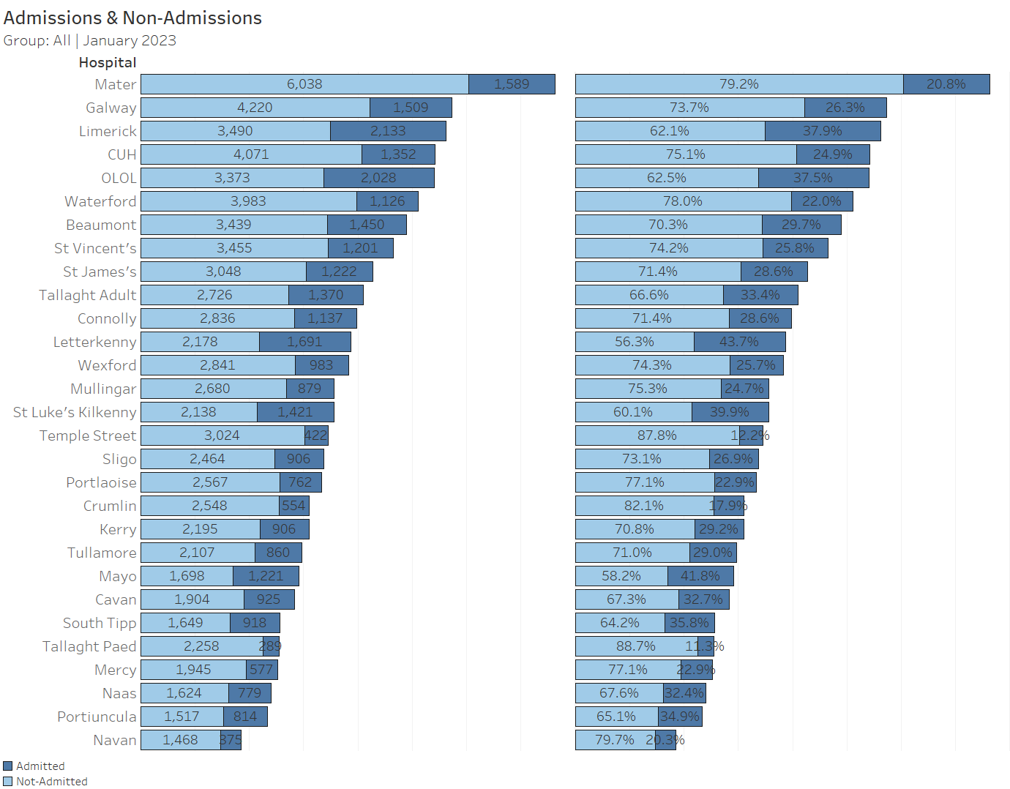
ED Attendances Ranked
17

Slide 18
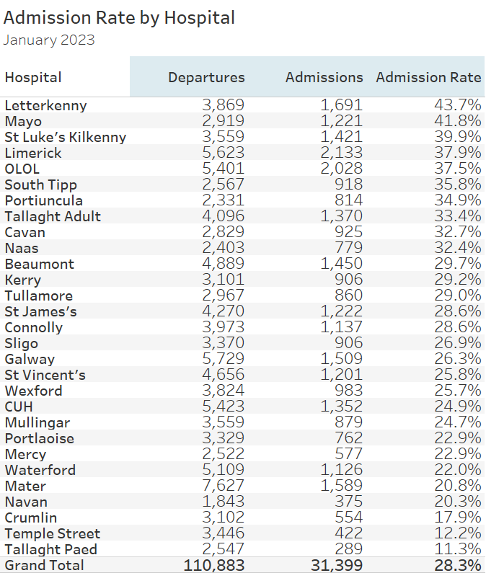
ED Departures By Admission Rate
18

Slide 19
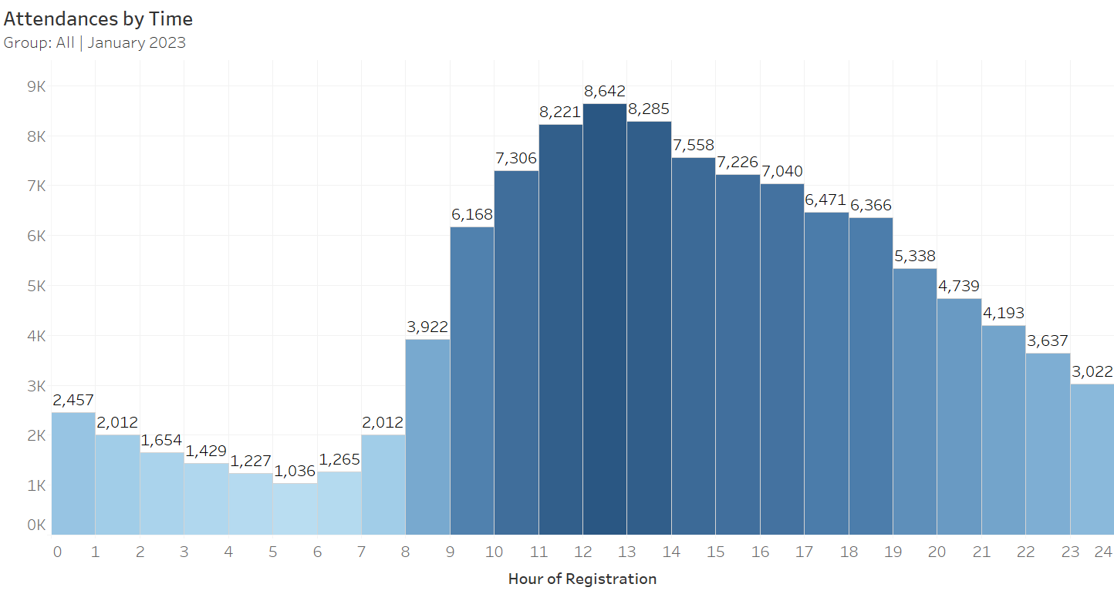
Monthly Attendances By Hour of Registration
19

Slide 20
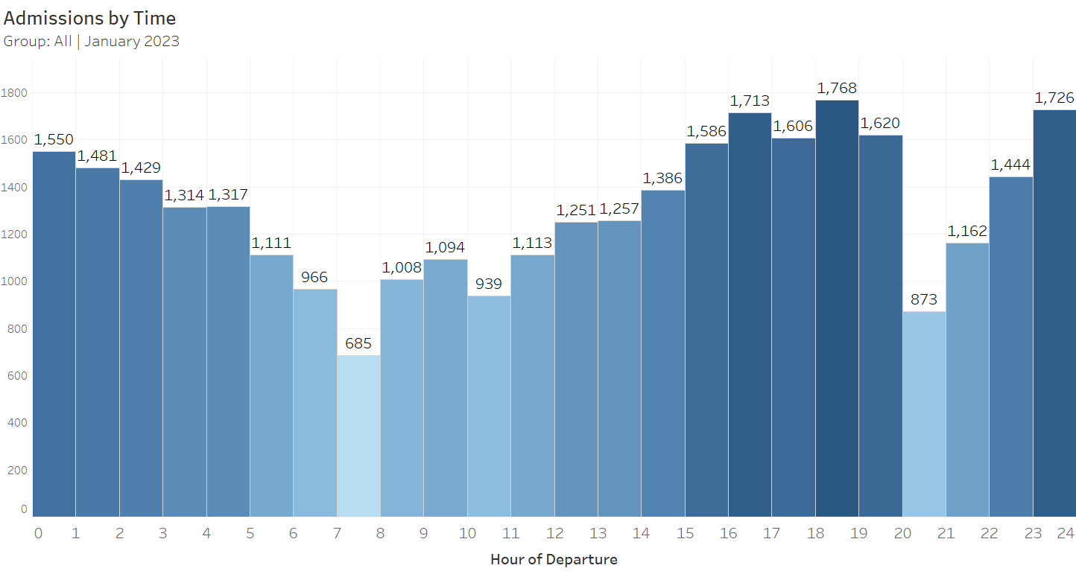
Monthly Admissions By Hour of Departure
20

Slide 21
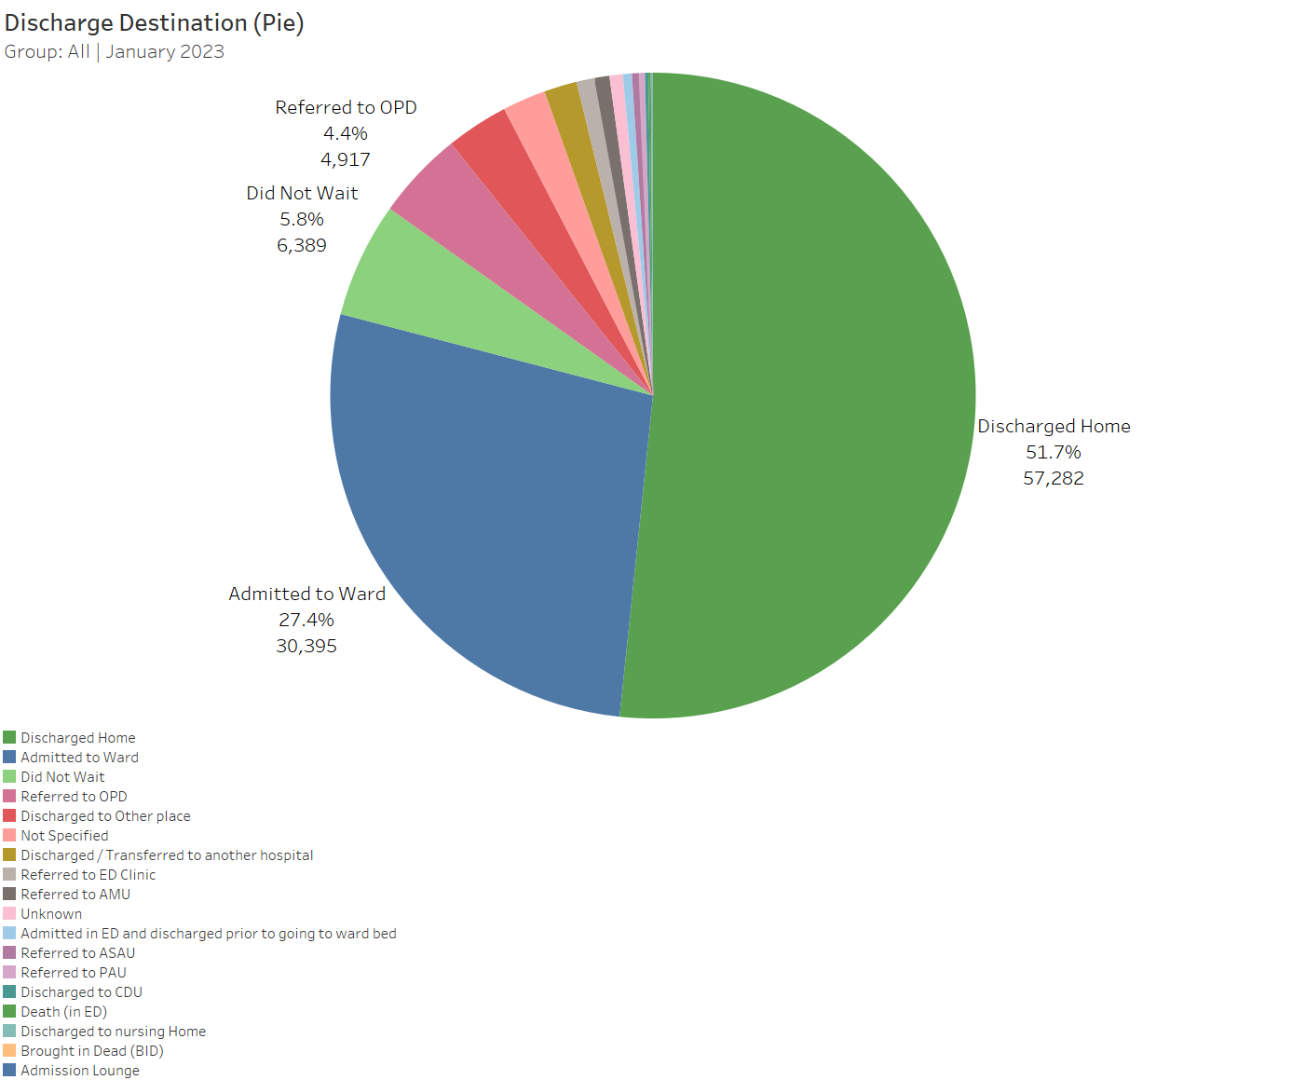
Discharge Destination (Pie Chart)
21

Slide 22
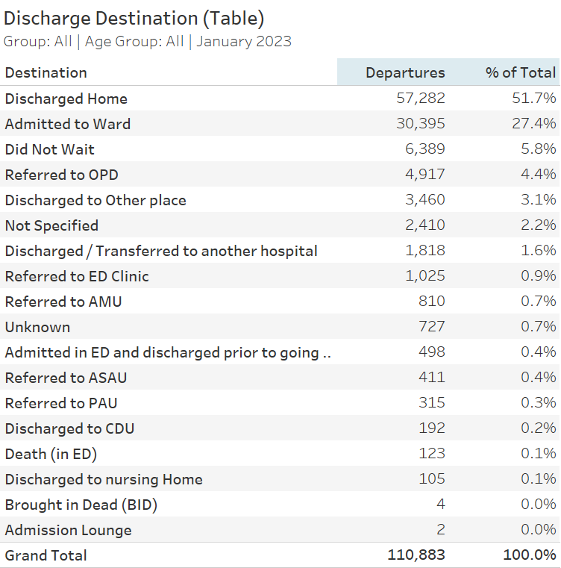
Discharge Destination (Table)
22

Slide 23
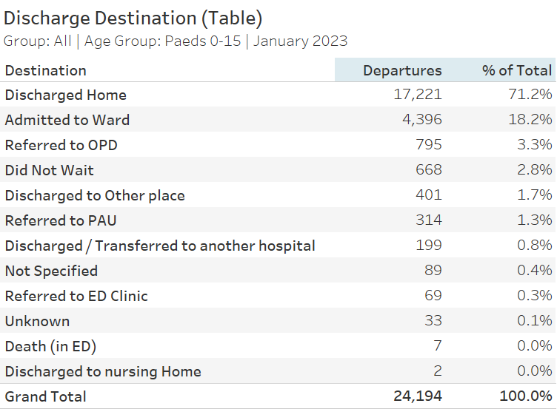
Discharge Destination (Table) - Paed
23

Slide 24
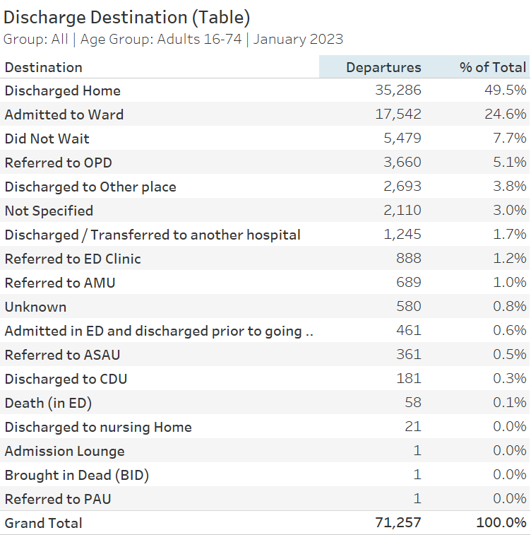
Discharge Destination (Table) – Adult
24

Slide 25
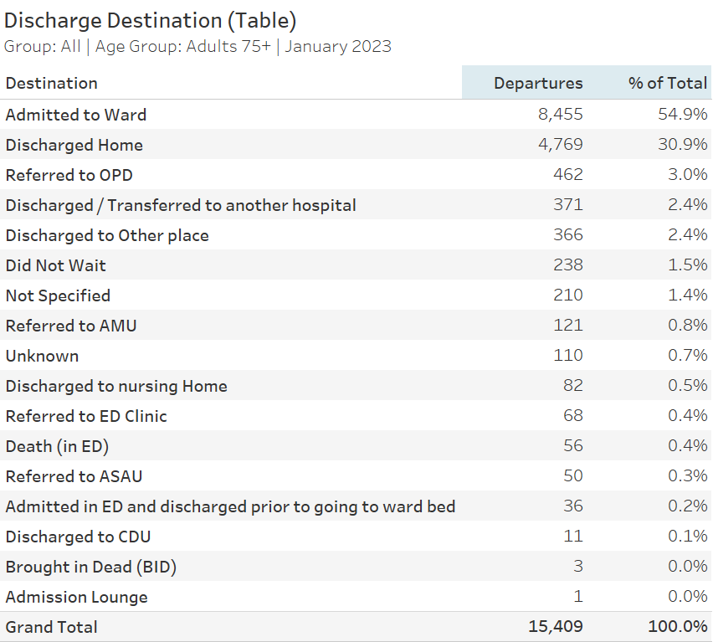
Discharge Destination (Table) – 75+
25

Slide 26
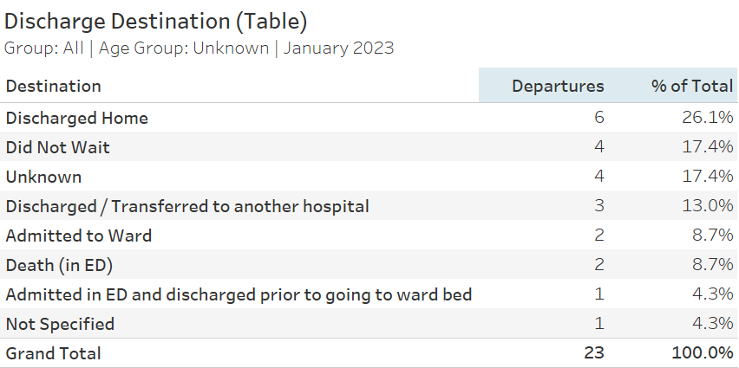
Discharge Destination (Table) –Unknown
26

Slide 27
Emergency department Quadrant
27

Slide 28
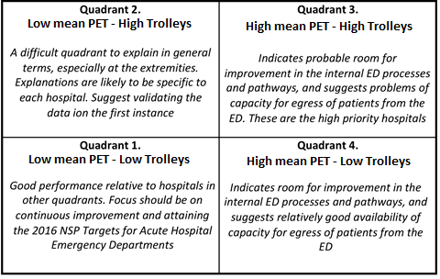
ED Quadrant Analysis & Interpretation
The “Quadrant” is a graphical two-dimensional relative analysis of the acute hospitals offering ED services, where the two dimensions are:
Mean PET
Normalised 8am TrolleyGAR trolley count
The mean PET performance for the period in question is represented by the X-Axis. Only patients with an age > 15 on registration are used in the mean PET calculation.
The Y-Axis is a measure of the 8am TrolleyGAR trolley count per 100 adult attendees at the ED during the period. This “normalised” trolley count is suitable for hospital-to-hospital comparisons
For ease of interpretation, the chart is sub-divided into four quadrants, defined by the median mean PET and the median Trolleys per 100 Adult Attendees.
As a general rule:
Low mean PET and Low Trolleys – GOOD
High mean PET & High Trolleys – BAD
The graphic to the right can be used as guidance to the interpretation of each of the four quadrants.

Slide 29
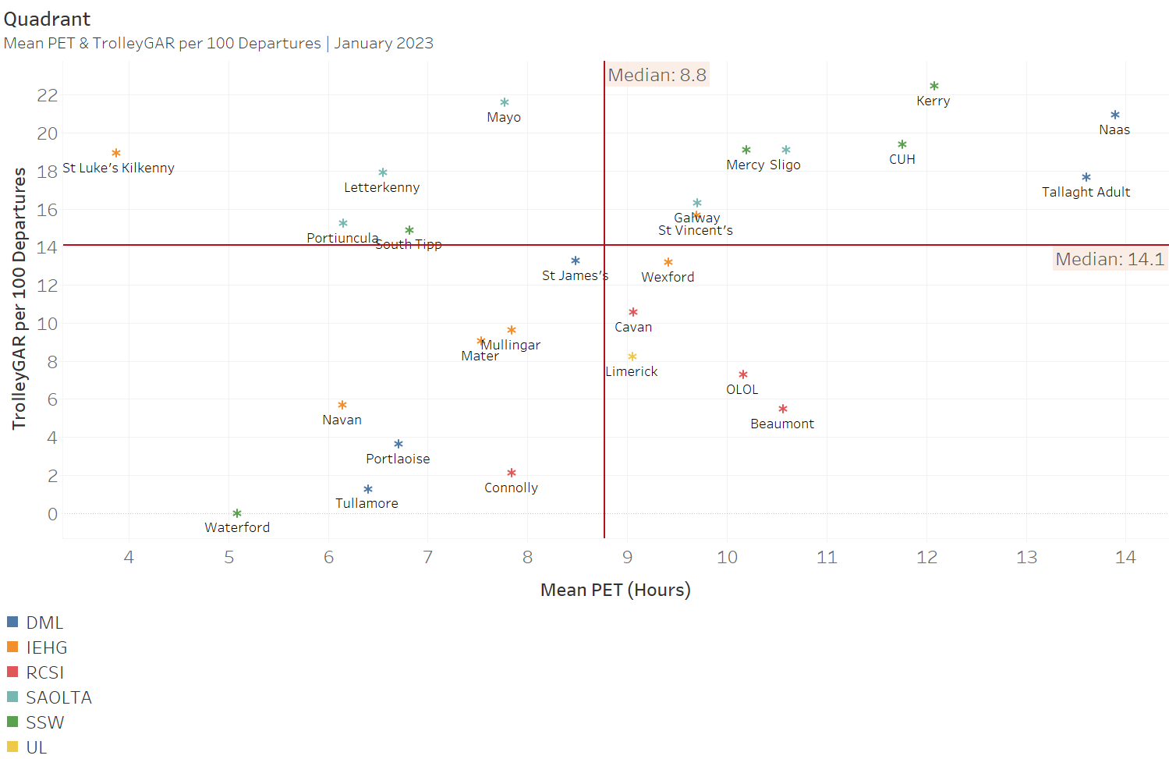
Mean PET & 8AM TrolleyGAR per 100 ED Departures
Note: The mean PET is calculated on the subset of records with an age greater than 15, departing in the reporting month.
29

Slide 30
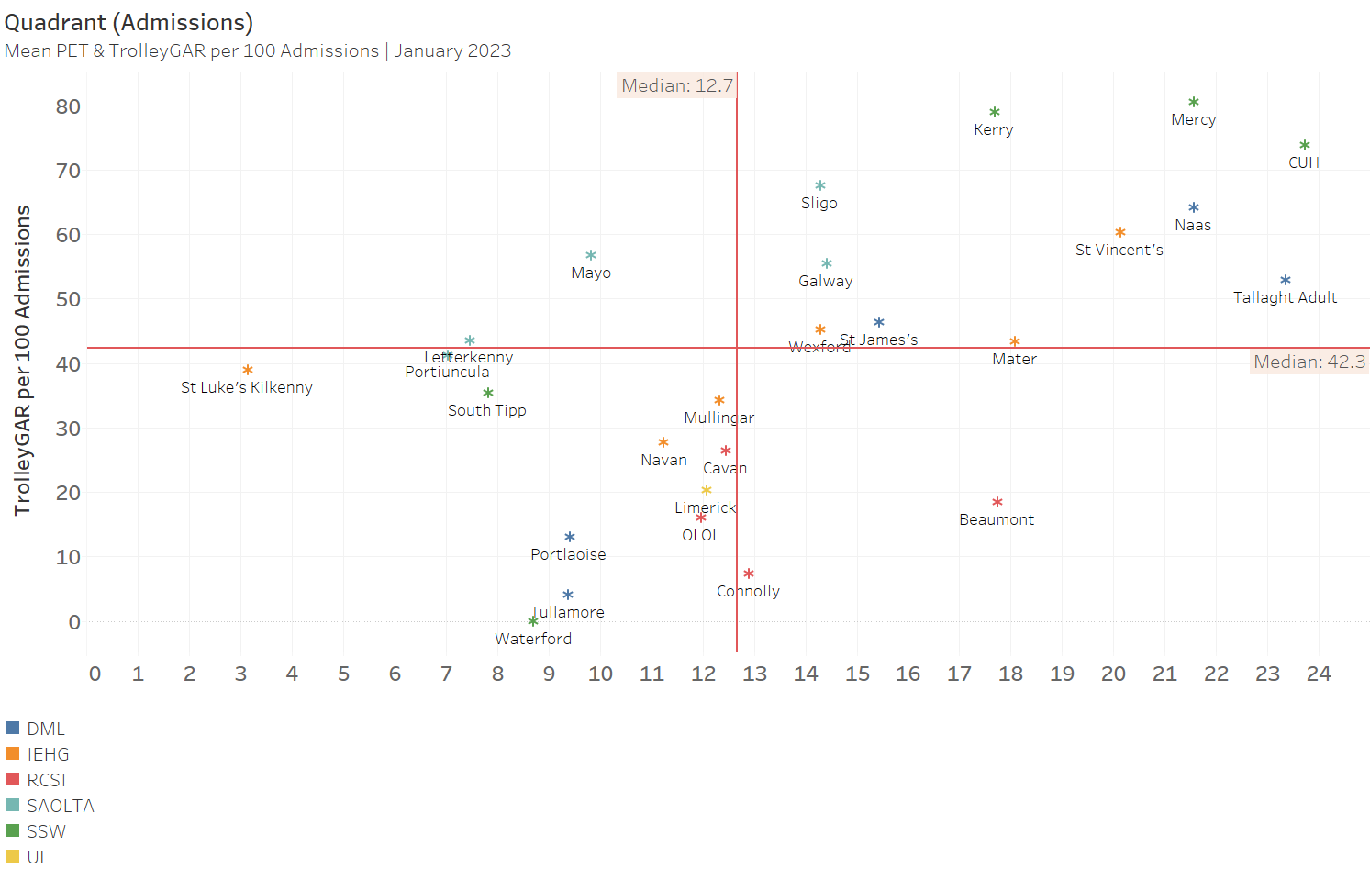
Mean PET & 8AM TrolleyGAR per 100 ED Admissions
Note: The mean PET is calculated on the subset of records with an age greater than 15, admitted in the reporting month.
30

Slide 31
Emergency department PET
31

Slide 32
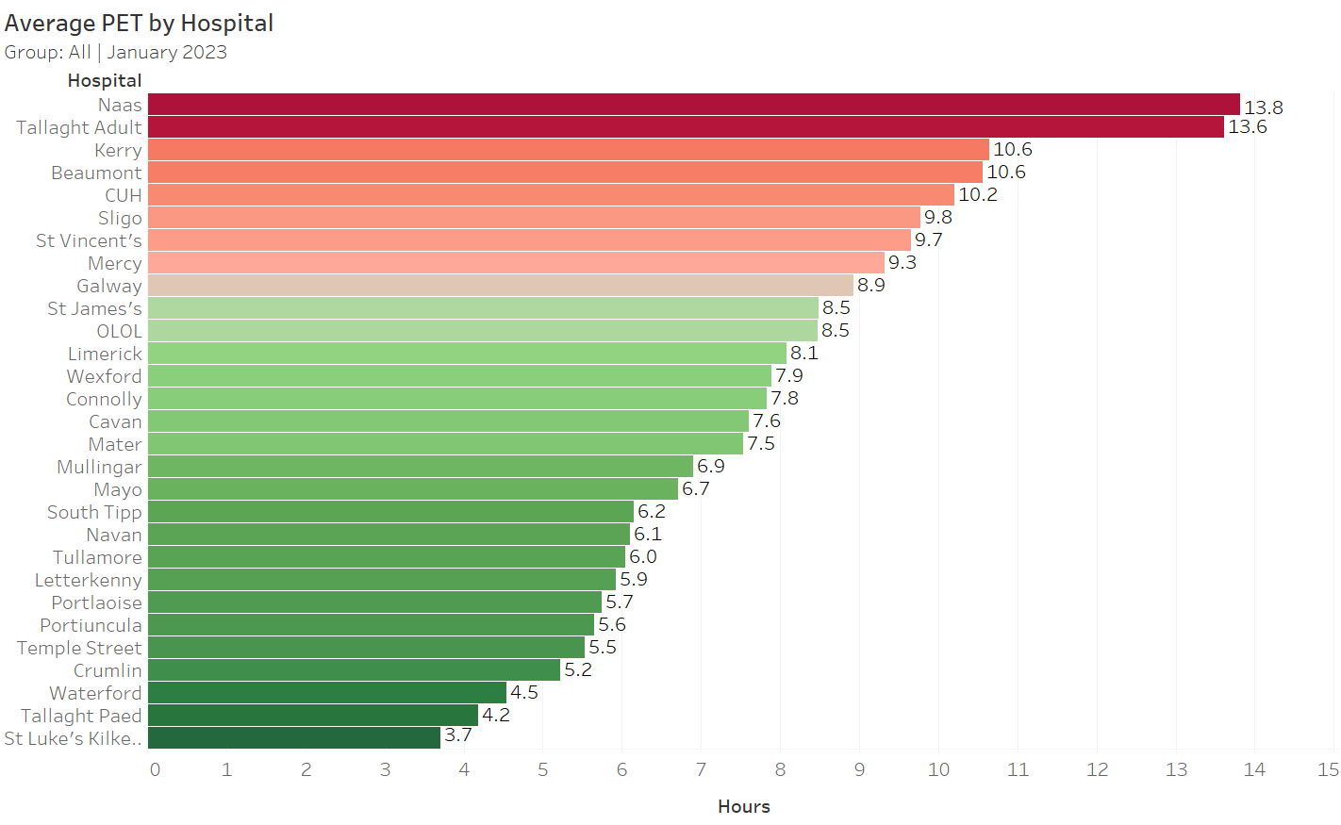
Average PET by Hospital
32

Slide 33
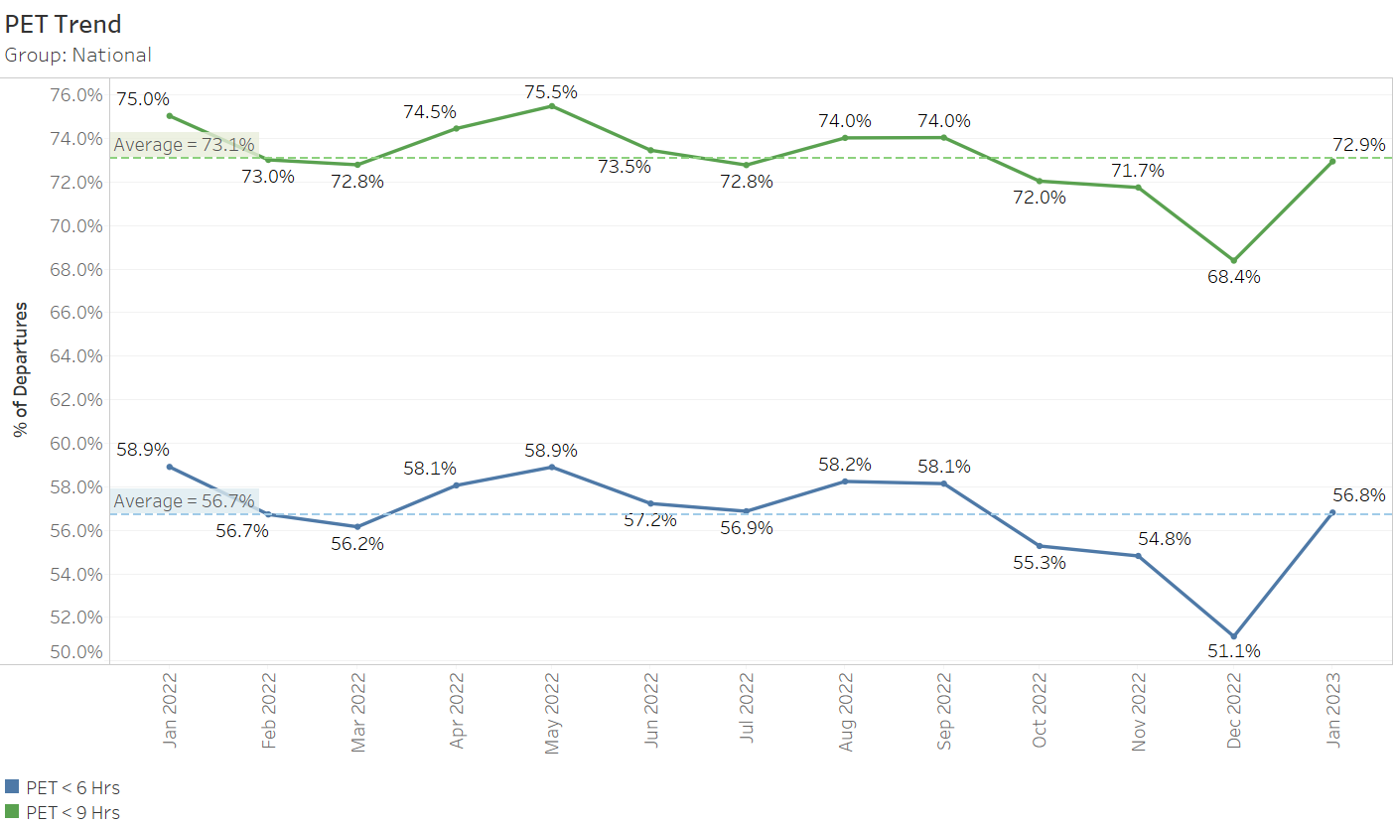
Performance to 6 and 9 Hour PET
33

Slide 34
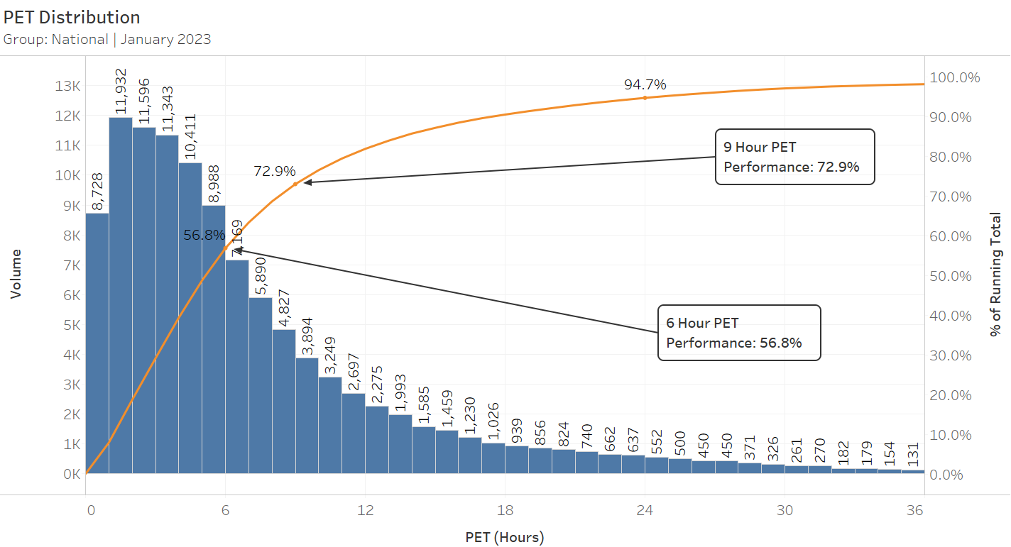
PET Distribution
34

Slide 35
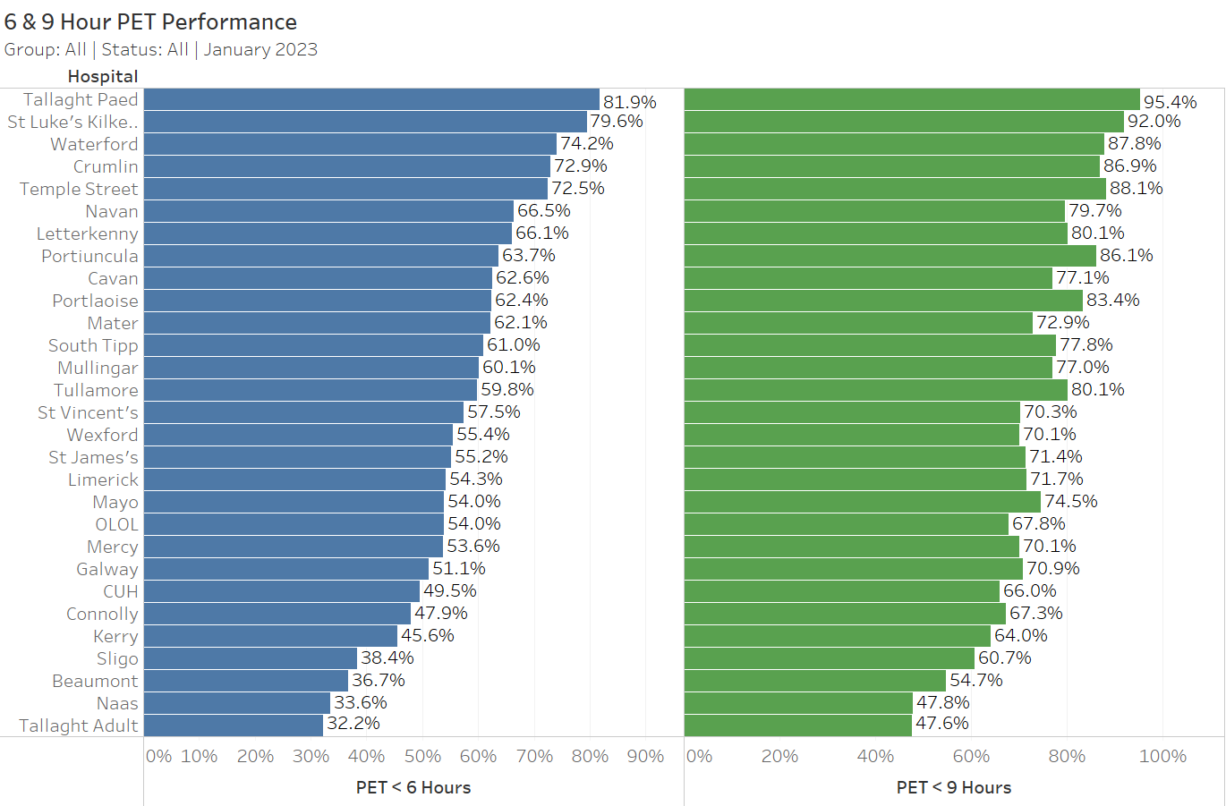
6 & 9 hour PET (All) – Hospital Detail
35

Slide 36
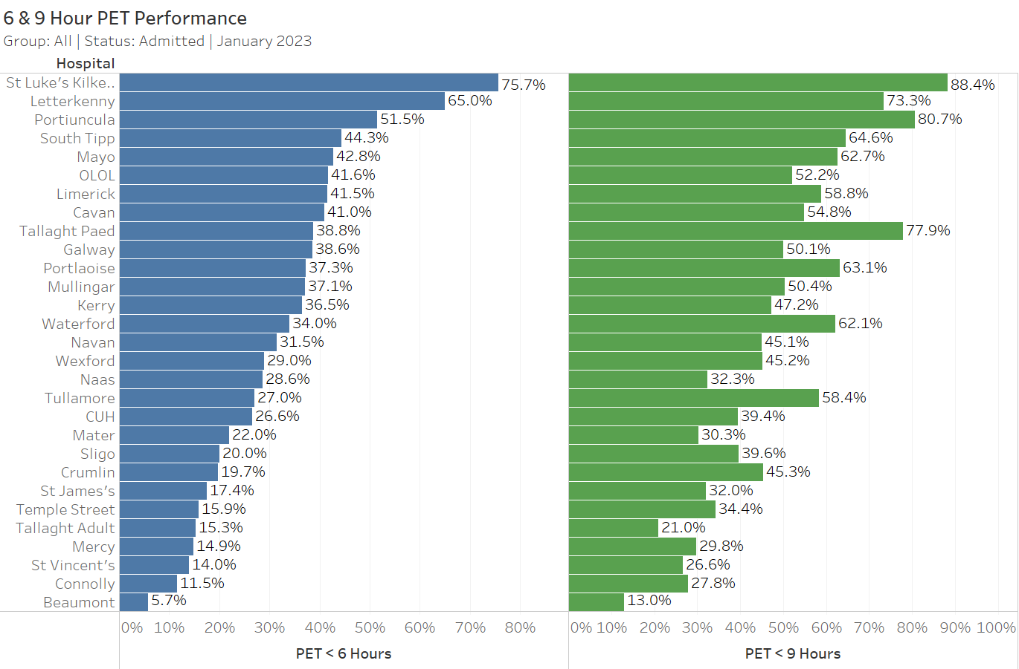
6 & 9 Hour PET (Admitted) – Hospital Detail
36

Slide 37
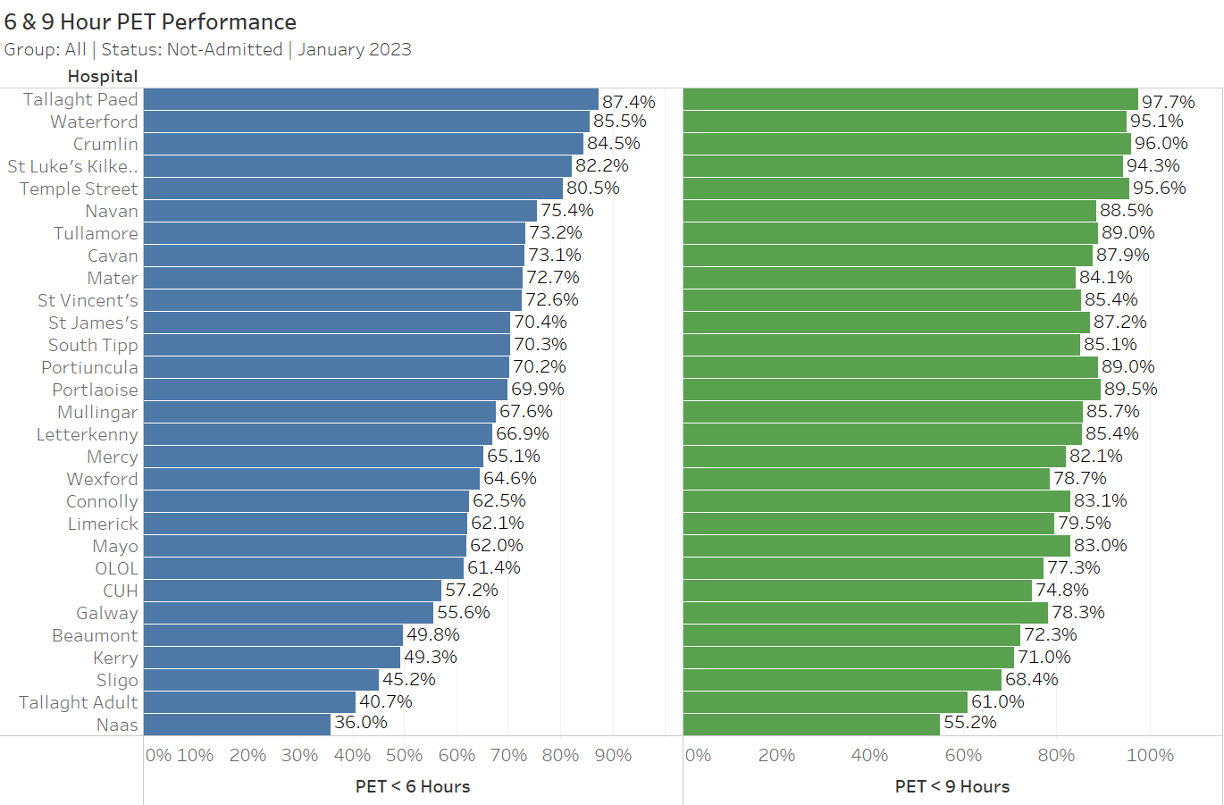
6 & 9 Hour PET (Not-Admitted) – Hospital Detail
37

Slide 38
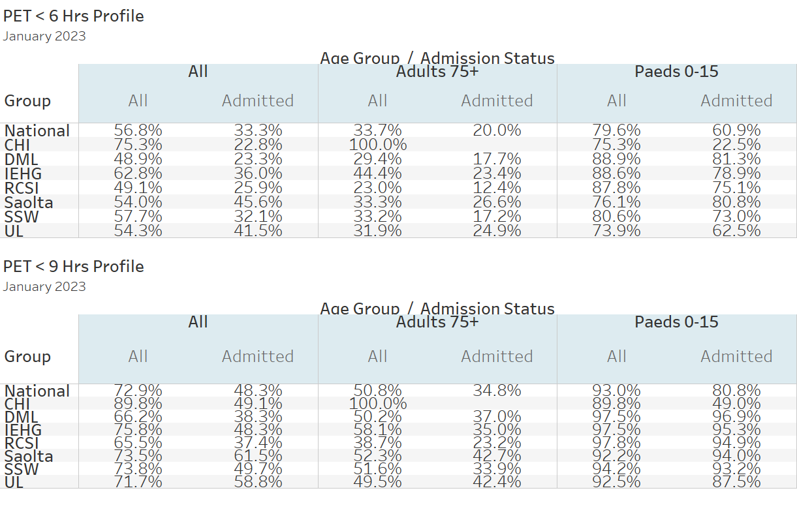
6 & 9 Hour PET by Selected Patient Cohorts
38

Slide 39
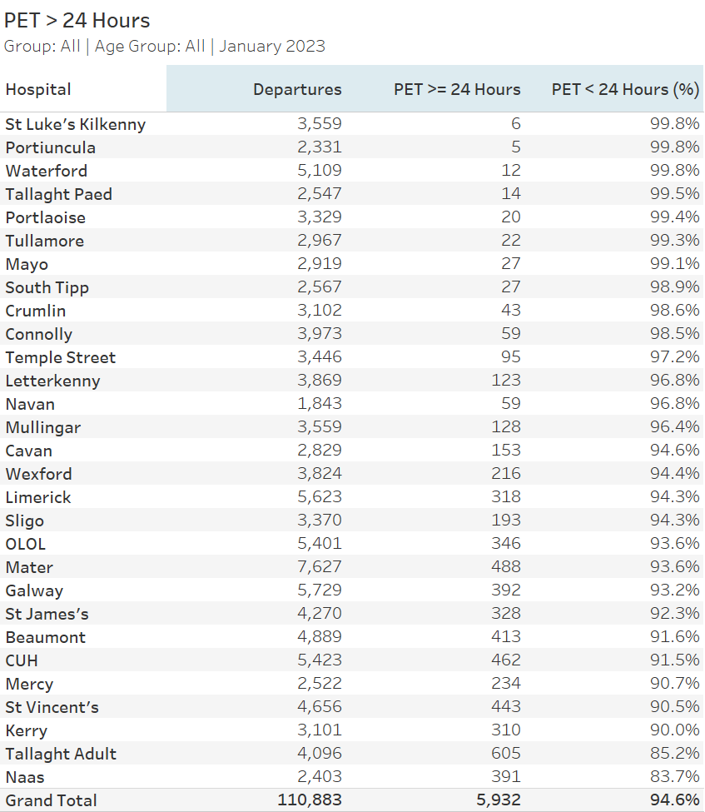
PET Greater Than 24 Hours
39

Slide 40
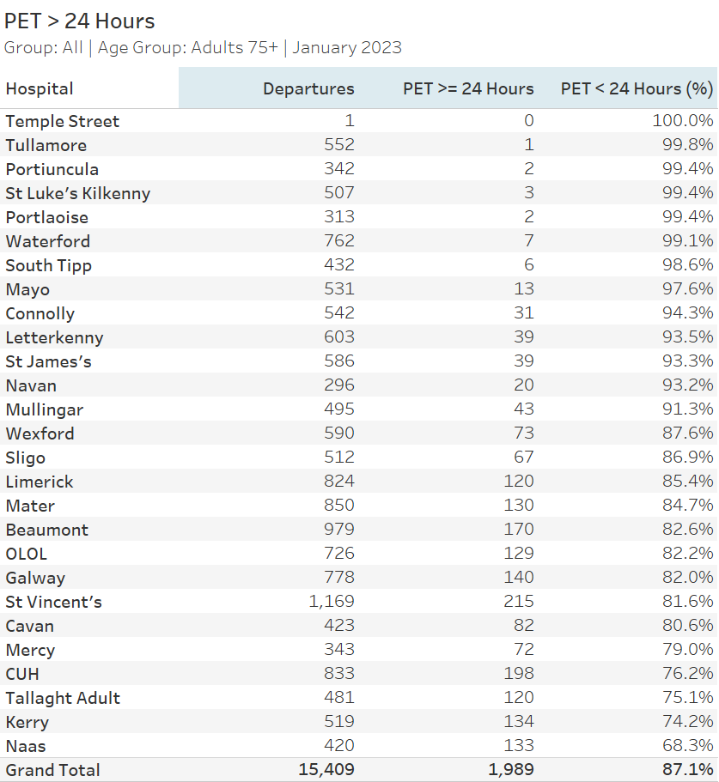
PET Greater Than 24 Hours (Ages 75+)
40

Slide 41
Emergency department trolleys
41

Slide 42
8AM Trolley Count: Month & YTD 2023 v 2022
8am TrolleyGAR
 |  | 2023 |  |  | 2022 |  |  | Difference
Hospital Group | Hospital | January | YTD |  | January | YTD |  | January | YTD
Dublin Midlands Hospitals Group | Naas | 500 | 500 |  | 345 | 345 |  | +44.9% | +44.9%
 | Portlaoise | 82 | 82 |  | 179 | 179 |  | -54.2% | -54.2%
 | St James's | 567 | 567 |  | 213 | 213 |  | +166.2% | +166.2%
 | Tallaght Adult | 724 | 724 |  | 440 | 440 |  | +64.5% | +64.5%
 | Tullamore | 34 | 34 |  | 322 | 322 |  | -89.4% | -89.4%
Ireland East Hospital Group | Mater | 689 | 689 |  | 486 | 486 |  | +41.8% | +41.8%
 | Mullingar | 255 | 255 |  | 403 | 403 |  | -36.7% | -36.7%
 | Navan | 104 | 104 |  | 37 | 37 |  | +181.1% | +181.1%
 | St Luke's Kilkenny | 508 | 508 |  | 279 | 279 |  | +82.1% | +82.1%
 | St Vincent's | 724 | 724 |  | 516 | 516 |  | +40.3% | +40.3%
 | Wexford | 386 | 386 |  | 232 | 232 |  | +66.4% | +66.4%
RCSI Hospitals Group | Beaumont | 267 | 267 |  | 0 | 0
 | Cavan | 225 | 225 |  | 105 | 105 |  | +114.3% | +114.3%
 | Connolly | 84 | 84 |  | 5 | 5 |  | +1580% | +1580%
 | OLOL | 289 | 289 |  | 106 | 106 |  | +172.6% | +172.6%
Saolta Healthcare University Hospital Group | Galway | 722 | 722 |  | 980 | 980 |  | -26.3% | -26.3%
 | Letterkenny | 575 | 575 |  | 252 | 252 |  | +128.2% | +128.2%
 | Mayo | 495 | 495 |  | 552 | 552 |  | -10.3% | -10.3%
 | Portiuncula | 256 | 256 |  | 103 | 103 |  | +148.5% | +148.5%
 | Sligo | 528 | 528 |  | 459 | 459 |  | +15% | +15%
South/South West Hospital Group | CUH | 813 | 813 |  | 554 | 554 |  | +46.8% | +46.8%
 | Kerry | 567 | 567 |  | 314 | 314 |  | +80.6% | +80.6%
 | Mercy | 404 | 404 |  | 655 | 655 |  | -38.3% | -38.3%
 | South Tipp | 295 | 295 |  | 213 | 213 |  | +38.5% | +38.5%
 | Waterford | 0 | 0 |  | 0 | 0
University of Limerick Hospital Group | Limerick | 358 | 358 |  | 450 | 450 |  | -20.4% | -20.4%
National |  | 10,451 | 10,451 |  | 8,200 | 8,200 |  | +27.5% | +27.5%
Note that the month total differs from the figure posted on https://edtf.healthatlasireland.ie/pinzon/dashboard/, this is due to the exclusion of the CHI group from this section of the report.
42

Slide 43
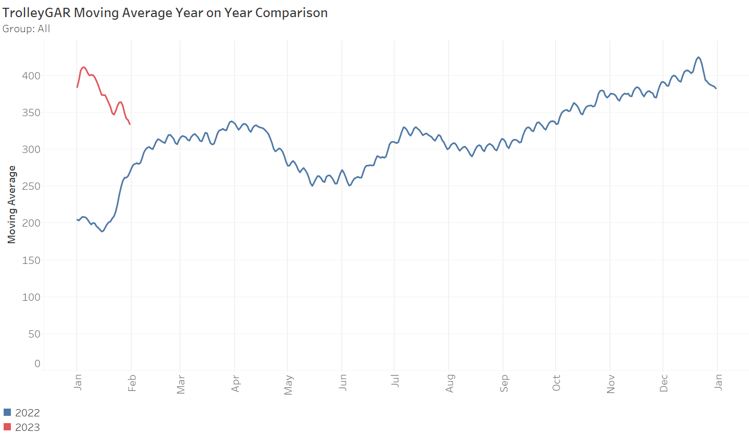
30 Day Moving Average 2023 v 2022
43

Slide 44
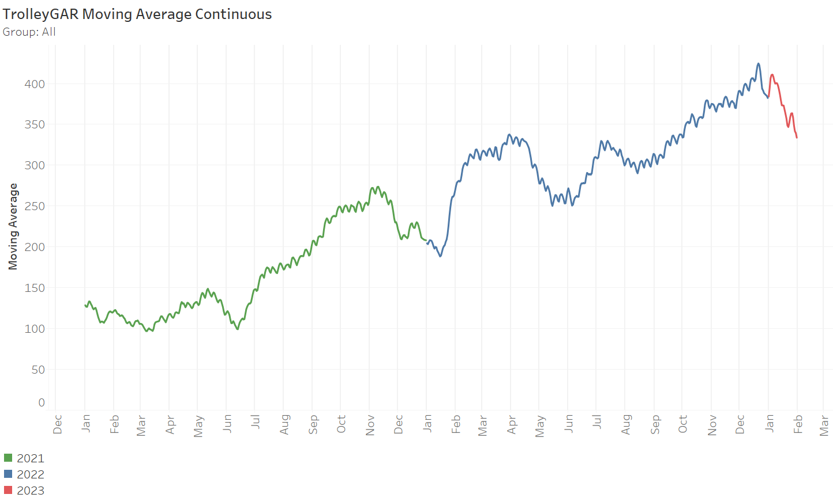
30 Day Moving Average 2021 to 2023
44

Slide 45
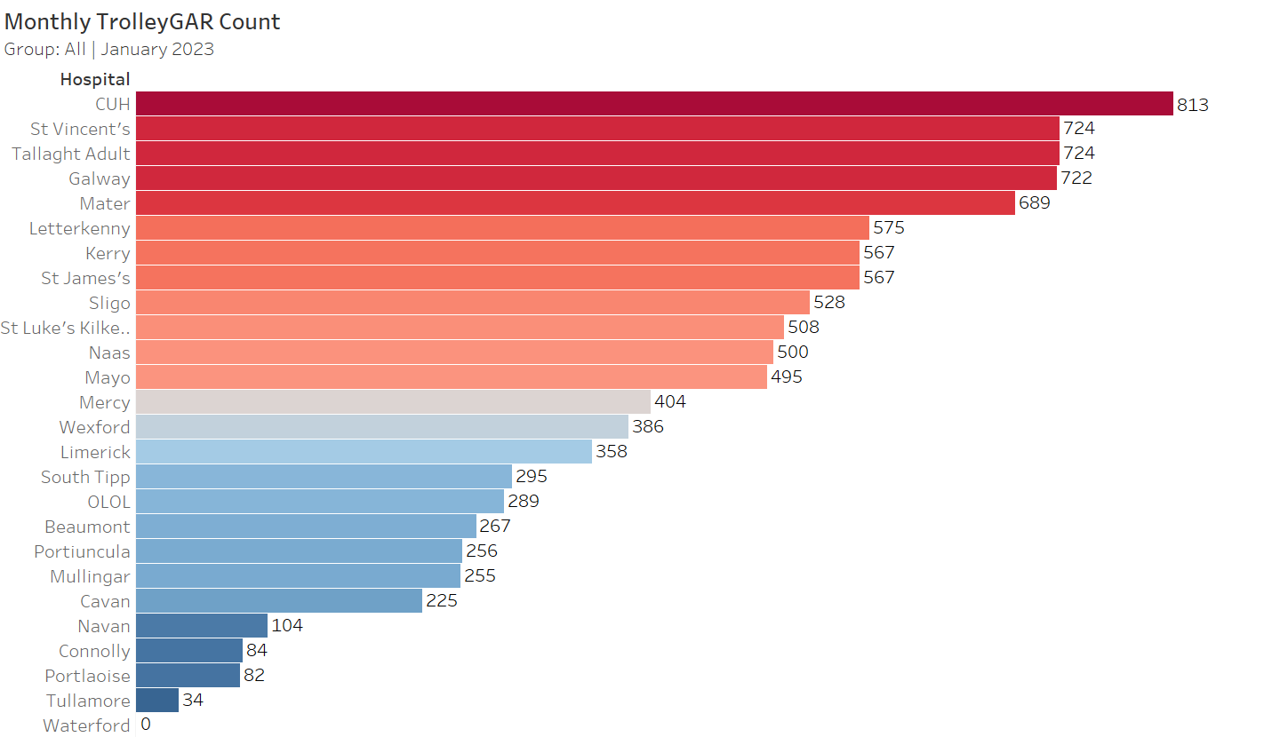
Monthly Trolley Count by Hospital
45

Slide 46
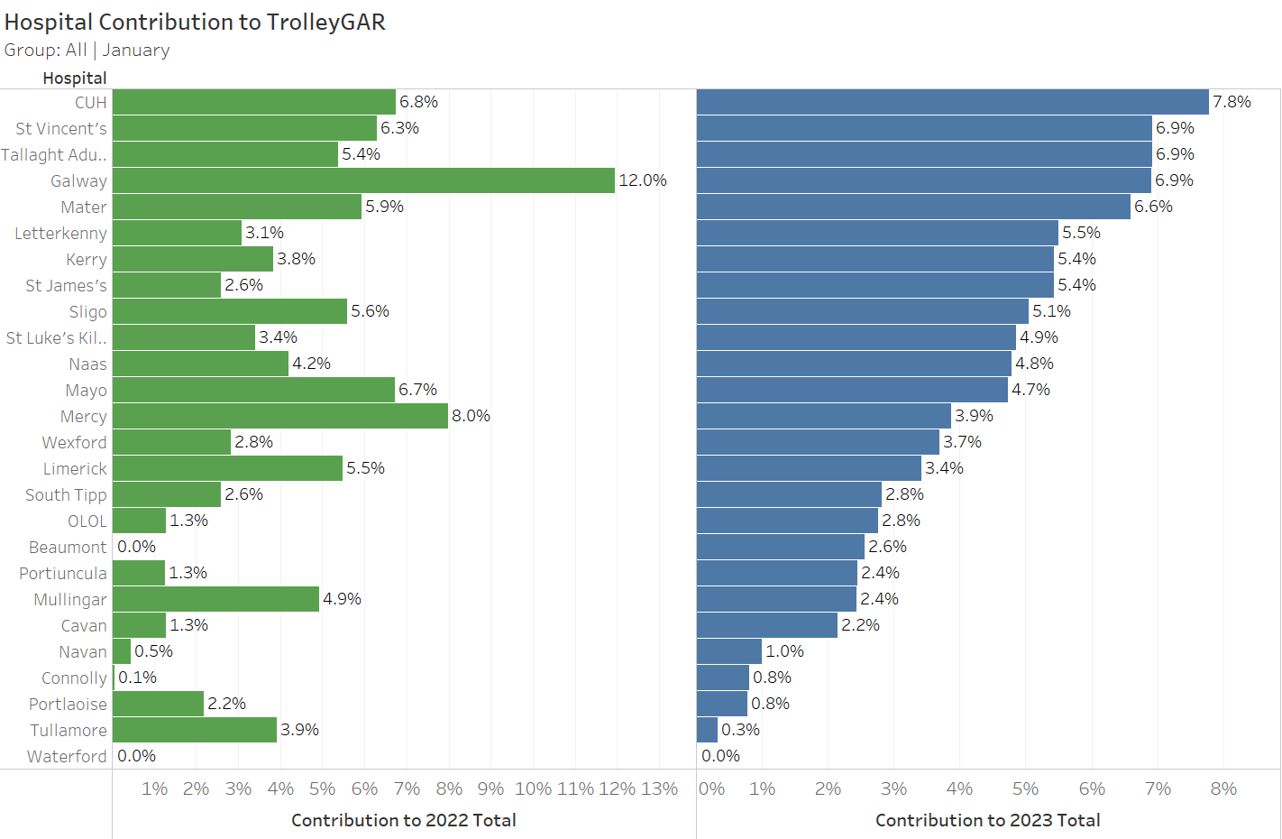
% Trolley Contribution 2023 v 2022
46

Slide 47
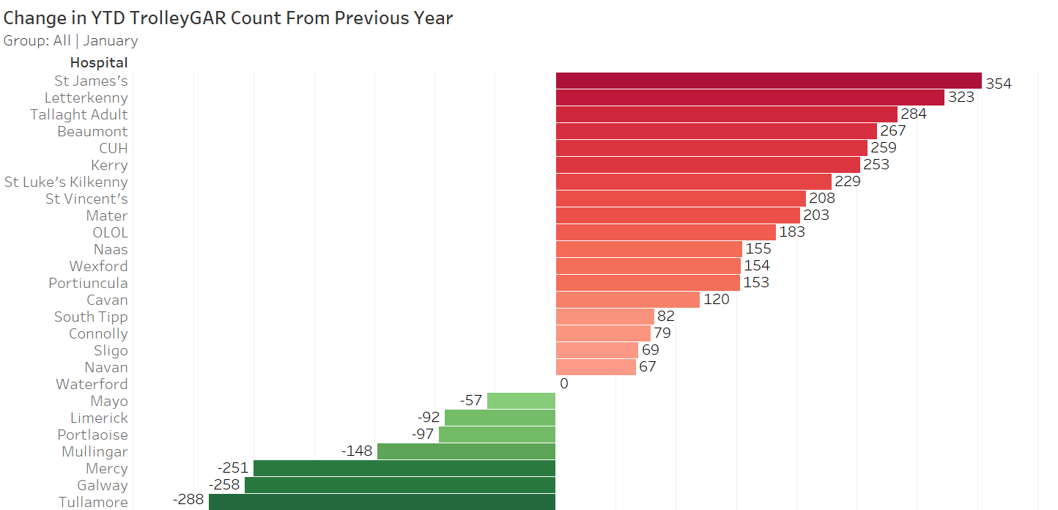
2023 v 2022 Total Change in YTD 8am Trolleys
47

Slide 48
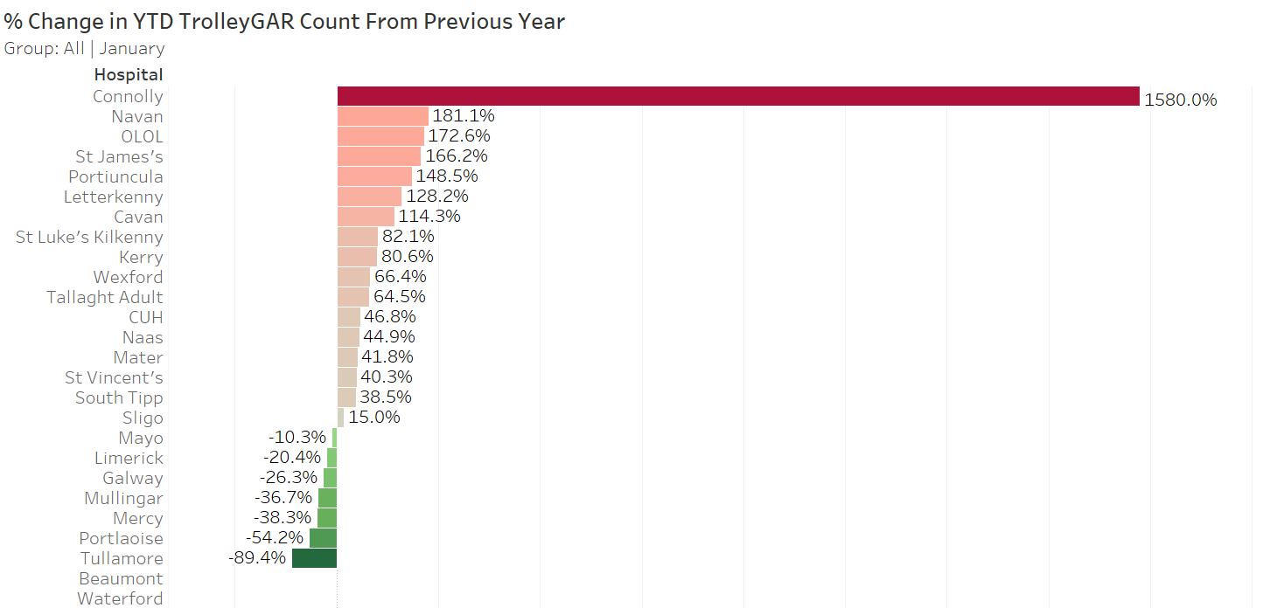
2023 v 2022 % Change in YTD 8am Trolleys
48

